Slide 1



UN Comtrade
Data Processing and Dissemination
Jiayue Zeng
United Nations Statistics Division
Notes:
Hello everyone, welcome to UN Comtrade Data Processing and Dissemination session. I am Jiayue from the United Nations Statistics Division.

Slide 2

Outline
UN Comtrade (+)
Data Processing System: CoprA+
  Form of Data
  Data Processing
  Data Review
Data Dissemination strategy
Notes:
So for this session, I gonna firstly give you an overview of the UN Comtrade, and then talk about our Data processing system and data dissemination strategy.

Slide 3
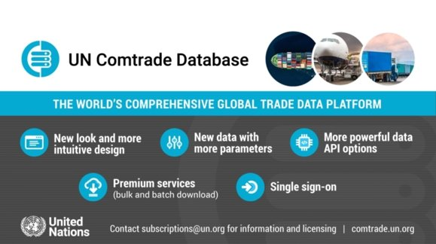
UN Comtrade
Repository of official international trade statistics​
  Extensive and detailed global trade data​
  Merchandise trade data (annual and monthly)​
  Services trade data (annual)​
Records and data size
  Tens of billion records in UN Comtrade+​
  imports and exports reported by statistical authorities of close to 200 countries/areas since 1962
Free public access ​
  Web-based query​
  API access​
  Bulk files download​
Link: https://comtrade.un.org/​
Notes:
Now, let me start with an overview of the UN Comtrade.
The UN COMTRADE is the repository of official international trade statistics. It provides extensive and detailed global trade data including annual and monthly merchandise trade data, as well as annual services trade data.
Now there are tens of billion records in UN Comtrade database, containing imports and exports reported by statistical authorities of close to 200 countries/areas since 1962.
Well, we released a brand new version of the UN Comtrade database last year. Here is the link to our official website.
It provides free public access to the data users around the world.
Users can get access to the data using like web-based queries, APIs and bulk files download.
The bulk file download feature offers a quick download of large amounts of prepackaged datasets in compressed files. As of mid-2023, there are around 230,000 datasets in UN Comtrade and the number keeps growing.
- So our API is backed by Azure API Management, offering automatic scalability and reliability during the spike in data demand, thus making the API suitable for production-level data pipelines.
- And user can also get data using bulk files download.
The bulk file download feature offers a quick download of large amounts of prepackaged datasets in compressed files.
The UN COMTRADE Database is maintained by the DESA/UN Statistics Division. It provides detailed imports and exports statistics in goods and services reported by statistical authorities of close to 200 countries/areas since 1962. It is considered the most comprehensive online trade database available, with tens of billions of data points.

Slide 4
Main Data Elements
Reporter: The country or geographic area to which the measured statistical phenomenon relates
Period: The period of time to which the measured observation is intended to refer
Flow: Trade flow or sub-flow (exports, re-exports, imports, re-imports, etc.)
Classification Code: Product classification and produce code(HS, SITC)
Partner: The primary partner country or geographic area for the respective trade flow
Partner 2: A secondary partner country or geographic area for the respective trade flow
CPC: Customs or statistical procedure code
MOT: The mode of transport used when goods enter or leave the economic territory of a country
Value: Imports have CIF, and FOB; Exports have FOB
Quantity & Unit: value and unit of quantity
Net weight: Net weight in kilogram
Notes:
Next, here are the main data elements of the UN Comtrade database.
Basically, it has data elements including: reporter, reference period, flow (like trade flow or sub-flow), classification code and partner.
In our new version, now it also provides information of Partner 2 which is the secondary partner country, CPC – the customs or statistical procedure code, and MOT, the mode of transport used when goods enter or leave the economic territory of a country.
For the numeric data, the elements include trade value, quantity and unit, as well as net weight.
Speaking of trade value, for imports, it has both CIF and FOB recordings, and for exports it has FOB recordings.
Previously, import value had both of records of CIF and FOB, and export value, it has FOB records.
Traffline data:
Final data: estimation, aggregation
Trade matrix: present by region

Slide 5
Metadata of UN Comtrade
Structural metadata: The wiki page includes structural metadata https://unstats.un.org/wiki/display/comtrade
Reference metadata: Reference metadata is on the Comtrade website, Data availability page: https://comtradeplus.un.org/DataAvailability. This page describes the relevant information when processing the data, such as the data collection date, data source, and new or revised dataset. It also includes items such as Currency, Conversion Factor, Trade system, Import/Export valuation, Publication Note.
Alternatively, you can query the metadata using the Python package “comtradeapicall”. See more at https://pypi.org/project/comtradeapicall
Notes:
Apart from the data, the metadata of the UN Comtrade Database is also easily accessed. It has both structural metadata and Reference metadata.
The wiki page for the UN Comtrade includes the structural metadata.
And the reference metadata is on the Comtrade website. Data availability page.

Slide 6
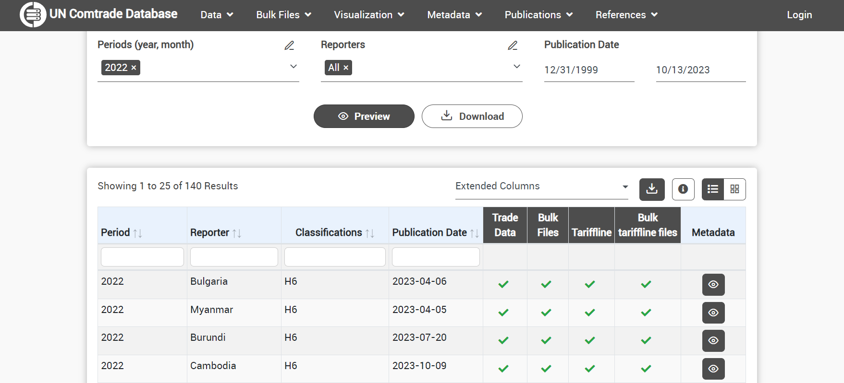
Metadata
Data availability page on UN Comtrade: https://comtradeplus.un.org/DataAvailability
Notes:
So here is the page. On this page, people can know the availability of each country’s monthly or annual trade data.
As you can see here, the user can do the query and preview the result table here.
And they can click on the last column of the result table to see the metadata. For example here.

Slide 7
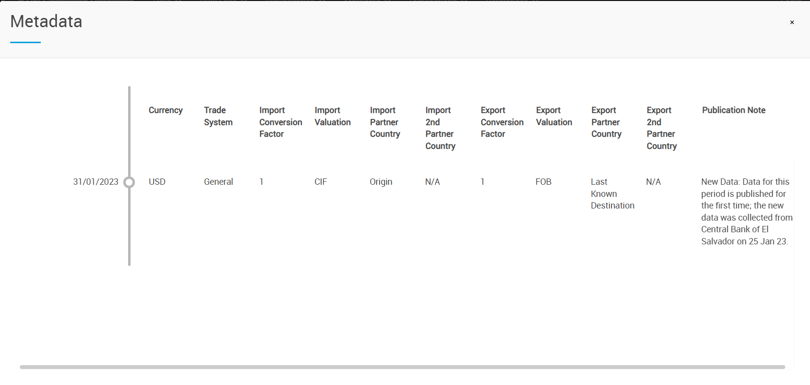
Metadata
Reference metadata on UN Comtrade: https://comtradeplus.un.org/DataAvailability
Notes:
For example here, the reference metadata includes items such as Currency, Trade system, Conversion Factor, Import/Export valuation, Publication Note and so on.

Slide 8
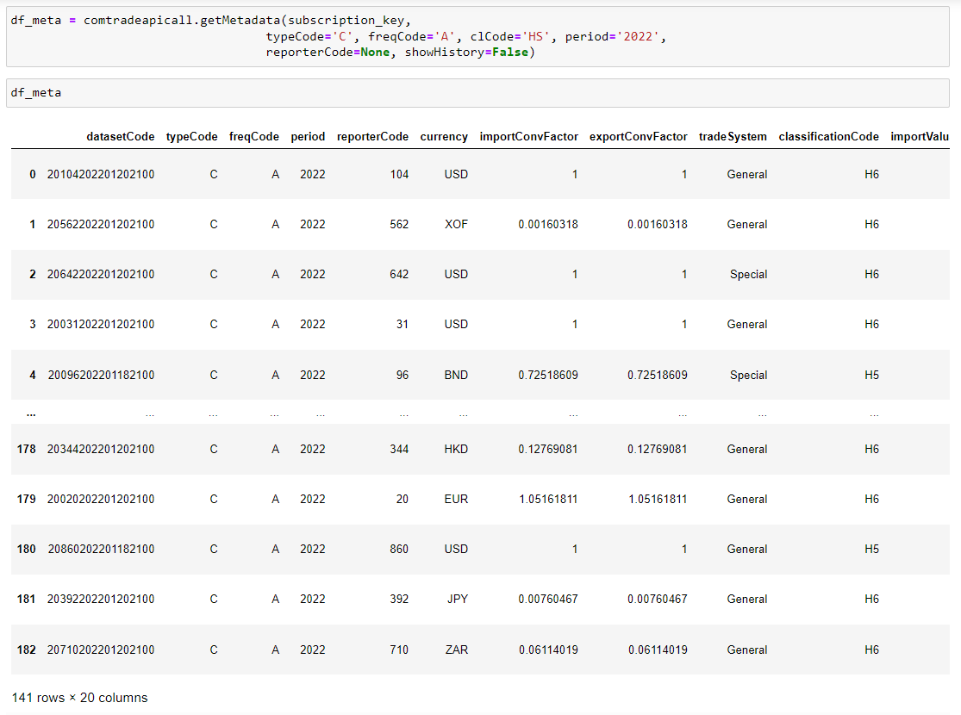
Metadata
Query the metadata using the Python package “comtradeapicall”.
Eg. Annual merchandise trade metadata of 2022
df_meta = comtradeapicall.getMetadata( subscription_key, typeCode='C', freqCode='A', clCode='HS', period='2022’, reporterCode=None, showHistory=False)
See more at: https://pypi.org/project/comtradeapicall
Notes:
Apart from this, for the user with tech background, they can also query the metadata using our python package: Comtrade API call.
If the user want to analyze our data using python. They can use this package to query the data and metadata.
So here is an example. We use the get Metadata function, to see the annual Merchandise trade metadata of 2022.
Here we use the comtradeapicall package and getMetadata function.
After running the code, you can see the result table here
And if you are interested in using python to query and analysis our data or metadata, you can learn more on this webpage.

Slide 9


UN Comtrade Data Pipeline
Data Request
Data Collection & Registration
Data Pre-Processing
Official request for trade data to data providers (Feb for commodities, July for services)
New and revised data
Receive data and send receipts
Data registration in CoprA+
Data is transformed to the standard input format
Data reference decks are prepared
Data Processing
Data Reviewing
& Validation
Data Publication
& Dissemination
Normalization and Harmonization of data
Quantity & weight estimation
Conversion to other classifications
Checking, reviewing and validation of mapping and values
Publication to UN Comtrade
Yearbook and other analytical products
Trade matrix
Notes:
Well, in general, that is what the UN comtrade database offers. So how is the data generated?
Therefore, next let me talk about the UN Comtrade data pipeline. Well, there are 6 steps: xxx
So for step 1 data request, we would send official requests for trade data to data providers every year. In February, we would send official letters to request for last year’s commodities trade data, and every July, we would send official letters to request for services trade data.
After receiving the data from each country’s National Statistics offices or other institutes we will send receipts to them, and then register the data in our system. Since we may receive data of different format, like txt, excel, or MS access.
Therefore, we would conduct the data pre-processing next step. That is transform the data into standard input format. And also prepare the data reference decks.
The next step is data processing. So this procedure includes Normalization and Harmonization of data, Quantity & weight estimation, and Conversion the data to other classifications. Those processes will be mainly done in our data processing system CoprA+.
Next before publish the data, we shall always do the data reviewing and validation. That is checking, reviewing and validation of mapping and values of the international trade data.
After all these steps, we would publish and disseminate the data.
FTP site – give country access
Trade matrix - Dissemination database – estimate missing data
Data processing is done by CoprA+ (automatically or manually?)

Slide 10
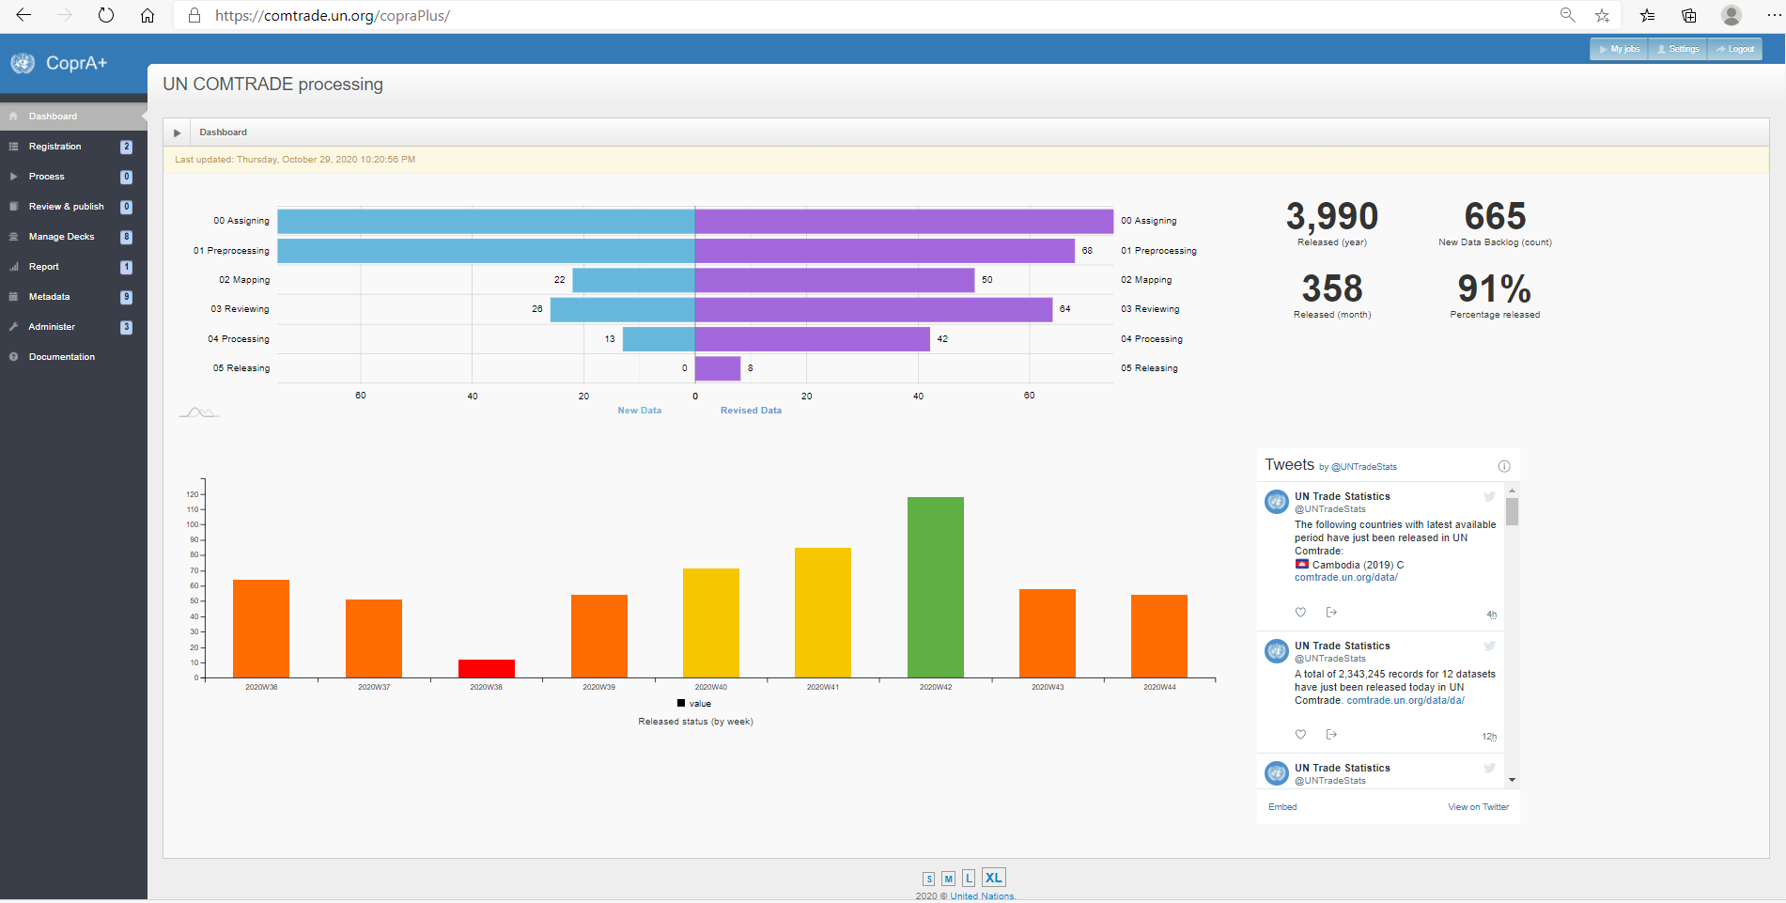
Data Processing System: CoprA+
Notes:
So many steps are being conducted in our CoprA+ system. Now, let me show you what does the data processing system CoprA+ looks like.
This is the main page of Copra+
As you can see the tabs here, we can do data registration, data processing, data review here. And we also store decks and metadata here.

Slide 11
Data Pre-Processing
Transform national data into the input format required by the internal processing system (shape, form, format, variable name and type)
Ensure that national code references are included for mapping to standard codes during the processing stage
Ensure accuracy and validity
  revision status; totals;
  categories inclusions/exclusions e.g. monetary gold; oil exports
  must include flow, ref period, commodity, reporter, partner codes, and value
Produce an output file in tab-delimited format
  retain original level of detail (no aggregation at this stage)
Notes:
Next, let us go into the details of Data Pre-Processing. Since we may receive data of different formats like database, excel, txt files. So, the first step is to Transform national data into the input format required by the internal processing system. We need to make that the shape, form, format and the variable name and type are consistent for every data file.
Usually, this is done by running python scripts.
Well, During the data pre-processing, it is really important to ensure that the national code references are included for mapping to standard codes.
And also we need to ensure the accuracy and validity of the data.
So we need to check the revision status, check if the totals are consistent.
And also make sure that every essential category are included, and .the categories that should not be included are excluded.
For example, we should not include monetary gold in trade records, therefore we need to make sure that the national data have excluded it.
Apart from this we also need to check if we have included all the essential data elements like flow, ref period, commodity, reporter, and partner codes, value
After the data pre-processing, we would produce an output file in tab-delimited format that retain original level of detail.
And to be noted we do not do data aggregation at this stage.

Slide 12
Data Pre-Processing: Some Challenges
National code references not being provided
National languages (descriptions and column names)
Missing data: Oil exports data not available for some oil exporters
Lack of detail
  confidential data; commodities not at 6-digit level; no partner detail;
High percentage of invalid commodity codes resulting in big residuals
Notes:
So that is how we conduct the data pre-processing.
Well, during the data pre-processing stage we may face some challenges
For example:
●Some times, National code references not being provided
●Or descriptions sometimes are in national languages, or data item names are in national languages and have special characters
●Also we may face with missing data issues, like: Oil exports not available for some oil exporters
●And sometimes, we also face with the challenge of lack of detail
oIt can be because of confidential data;
oOr commodities are not at 6-digit level;
oOr there are no partner detail;
●Apart from this we also face with the challenge of high percentage of invalid commodity codes resulting in big residuals

Slide 13
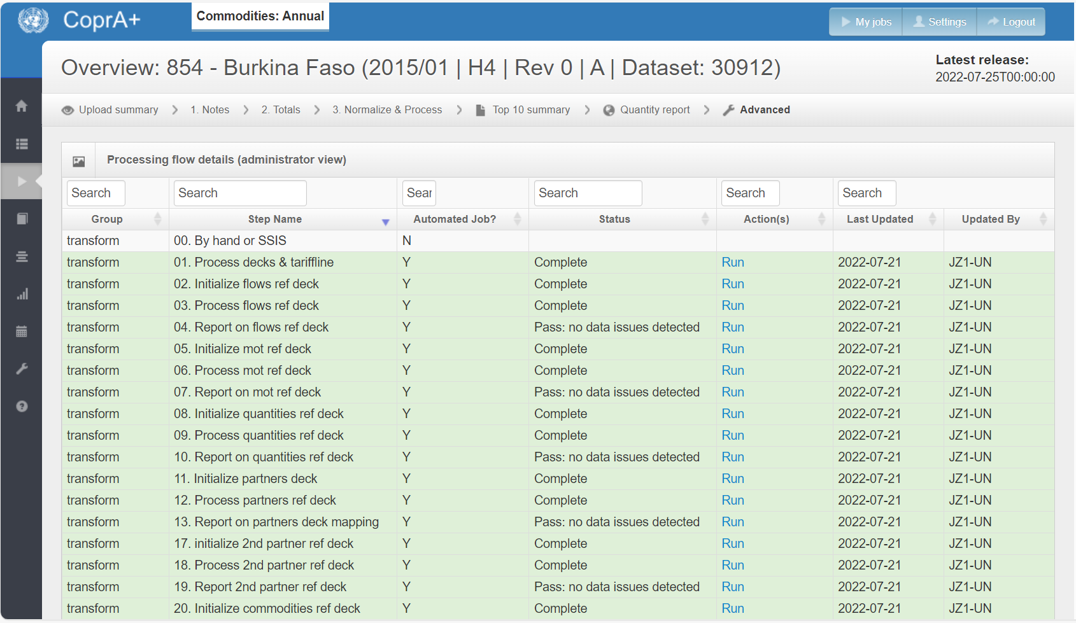
Data Processing
Data processing is done with the assistance of CoprA+
Notes:
After the data pre-processing, we would come to the data processing stage.
The Data processing is done with the assistance of our system CoprA+, the data processing system.
As you can see here, those are the step it would do for data processing.

Slide 14
Data Processing: Harmonization and Normalization
National data items are mapped to standard codes
  Partner names or codes to M49 codes
  Quantity units to World Customs Org (WCO) recommended units and UNSD extended units
  Mode of transport to UNSD units
  Revised Kyoto Convention for Customs Procedure Codes
  Currency conversion to USD
Output tariff line data that include records of international trade statistics (with 8-10 digit HS codes)
Notes:
One thing that should be done during the data processing is data Harmonization and Normalization.
During this procedure, national data items are mapped to standard codes, that is
oTrade Partner names or codes will be mapped to M49 codes
oQuantity units will be use World Customs Org (WCO) recommended units and UNSD extended units
oThe Mode of transport will be use UNSD units
oCustoms Procedure Codes will be using Revised Kyoto Convention
oAnd also we would convert the currency to USD
After this procedure, we could output tariff line data that include records of international trade statistics with 8-10 digit HS codes.

Slide 15
Data Processing: Quantity and Weight Information
Weight (net/gross) and supplementary quantity
Standardize quantity
  Quantity unit: according to WCO recommended units and UNSD standard quantity units
Conversion factors: based on mathematical or empirical relations (FAO and countries have developed conversion factors to facilitate the data exchange for specific commodities.)
Detect outlying quantity information
Estimate missing or “outlier” quantity information, if possible
Notes:
Next, about the quantity and weight information
As mentioned before, the UN Comtrade database also provides elements of net weight, gross weight, and supplementary quantity.
Since the quantity or quantity unit in trade statistics may vary from country to country, category to category. It is really important to standardize the quantity.
To standardize the quantity, firstly, the quantity unit would be converted according to WCO recommended units and UNSD standard quantity units.
After changing the quantity unit, we need a conversion factor to calculate the quantity.
The conversion factors can be based on mathematical or empirical relations. FAO and individual countries have developed conversion factors to facilitate the data exchange for specific commodities.
After the quantity is standardized, the next step is to detect outlying quantity information.
And if possible, we would estimate missing or “outlier” quantity information.

Slide 16
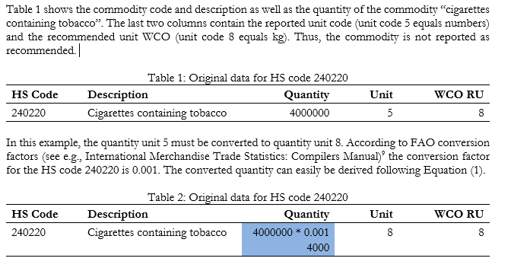
Data Processing: Example of quantity conversion
Notes:
Here is an example of quantity conversion.
The table 1 here, shows the commodity code and description as well as the quantity of the commodity.
In this case, the HS code is 240220, the description is”cigarettes containing tobacco”, the quantity is 4 million, and the unit code is 5 which stands for number. However, the WCO recommended unit 8 and that represents kg. Thus, the commodity is not reported as recommended.
Therefore, the quantity unit 5 shall be converted to quantity unit 8. According to FAO conversion factors, the conversion factor for this kind of commodity is 0.001. The converted quantity can easily be derived following this equation.
Now, this kind of quantity conversion can be done automatically by the data processing system CoperA+.

Slide 17
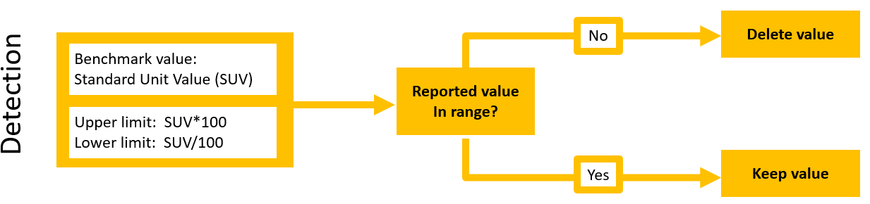
Data Processing: Extreme Quantity Detection
*Unit value equals to the trade value divided by the quantity.
Notes:
Next after the quantity conversion, let’s take a look at the extreme quantity detection.
We could use the standard unit value to detect extreme data. The unit value equals to the trade value divided by the quantity.
We have a benchmark value for each kind of commodity. We would check if the reported value is within the range. The upper limit for this range is the benchmark value*100, and the lower limit is the benchmark value/100
If the reported value is not in this range, then we will delete the value. If it is within the range, we will keep the value.

Slide 18
Data Processing: Quantity Estimation
Notes:
After the missing quantity or outlier quantity are detected, the next thing we would do is quantity estimation.
So, how to estimate the quantity?
Usually, we firstly check if the information is partially reported. If no, it will see if any information is missing. and if yes we would use the standard unit value approach to estimate the quantity.
If the information is partially reported, it then will check if the reported trade value is above threshold. If no we will still use the standard unit value approach. If yes, we can then use the weighted unit value approach to estimate the quantity.

Slide 19
Data Processing: Conversions to other Classifications
Data in a reported certain HS classification is converted to:
  earlier versions of HS
  Standard Int’l Trade Classification (SITC )
  Broad Economic Categories (BEC)
Based on WCO correspondence tables between HS versions
  UNSD developed conversion tables
  In the conversion process, prefer to convert most detailed level in original classification into one single code in the target classification, without splitting
Notes:
During the data processing, we also convert data to other classifications.
Like the international trade data in a reported certain HS classification is converted to:
earlier versions of HS
Standard Int’l Trade Classification (SITC )
Broad Economic Categories (BEC)
Based on WCO correspondence tables between HS versions
UNSD developed conversion tables
In the conversion process, it is preferred to convert most detailed level in original classification into one single code in the target classification, without splitting

Slide 20
Data Processing:
Conversions to other Classifications
UNSD maintains matrix of correlations and conversions
Link: https://unstats.un.org/unsd/classifications/Econ
Notes:
The UN Statistics Division maintains the matrix of correlations and versions
As you can see here, those are the matrix between different versions of HS
Here are the matrix between HS with SITC and BEC.
So if you want to learn more, the matrixed can be found on this webpage.

Slide 21
Data Review
Review person:
  Reviews by an editor and admin
Review elements:
  Check overall totals against official sources, time series, trends
  Verify the mapping of partners, commodities and quantity units
  Check value of non-standard commodity codes or unknown partners
Notes:
Now, let’s come to the next stage: Data review
Before publish the data, the data will be reviewed by the editor and an admin.
The things to be reviewed includes
Check overall totals against official sources, time series, trends
Verify the mapping of partners, commodities and quantity units
Check value of non-standard commodity codes or unknown partners

Slide 22
Data Review: CoprA+ Reports
Total Import/Export Time Series
*other official sources like the Ttrade data from IFS
Notes:
Let me show you some useful reports/graphs for the data review.
The first one is Total import or export time series.
As you can see here we would review the trend of the recent 6 year’s total trade amount.
And we would also compare each year’s total trade value of our data with the value from other official source like the Ttrade data from IFS. And to see if there are big gaps
Ttrade: IFS (actual)
Blue: upload
Green: published before

Slide 23
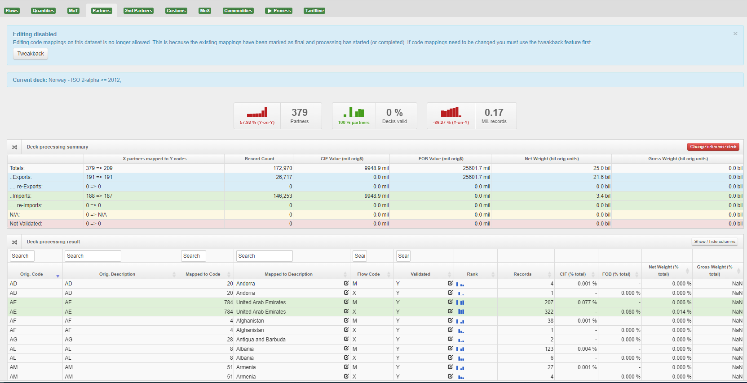
Data Review: CoprA+ Reports
Review code mapping (including partner code, commodity code, customer procedure code)
*Detect non-standard codes
Notes:
Next, here is the page for reviewing the code mapping, including partner code, commodity code, customer procedure code, etc.
In this page, the system could detect non-standard codes, and the editor would correct those non-standard codes manually

Slide 24
Data Review: CoprA+ Reports
  Top 10 Commodities of each reporter's import and export
Notes:
Apart from this, we would also review the top 10 commodities of each counties’ monthly or annual data. We would compare this year’s value with last year’s value to see if there are anything abnormal.

Slide 25
Data Review: CoprA+ Reports
  Top 10 Partners of each reporter's import and export
Notes:
Similarly, we would also review the Top 10 partners of each country’s imports and exports, and compare with last year’s data.

Slide 26
Data Release: UN Comtrade+
Notes:
After reviewing the data, we can come to the last stage: Data release.
We would release our data to the UN Comtrade database. Here is our official website. User can download the international trade data from this website.

Slide 27
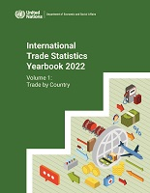
Data Publication: International Trade Statistics Yearbook
Volume I: Trade by Country (in June)
Volume II: Trade by Product (3-digit SITC)
World and Regional Trade Profiles
World exports by provenance and destination
World exports by commodity classes and by regions
Notes:
Apart from this, we also provide data publication like, international trade statistics yearbook.

Slide 28
Innovative and experimental uses of UN Comtrade data
https://comtradeplus.un.org/Visualization/Labs
Notes:
In our new UN comtrade platform, we have a section for innovative and experimental uses of UN Comtrade data.
And here is the page and link

Slide 29
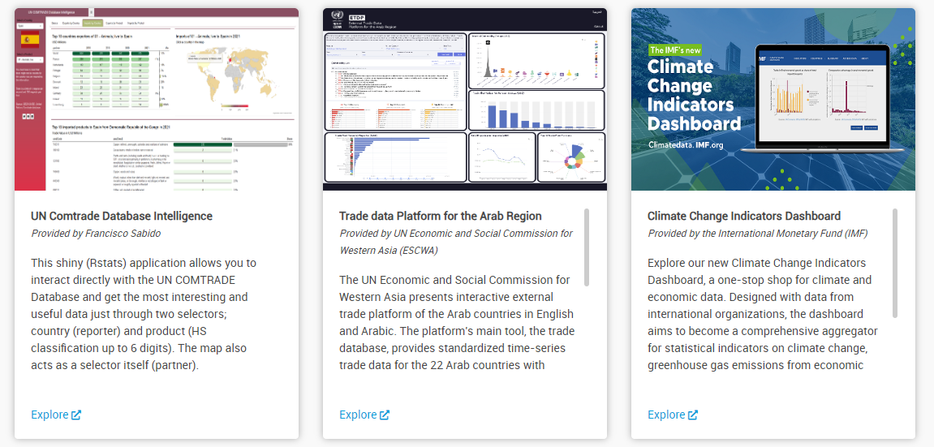
Innovative and experimental uses of UN Comtrade data
Notes:
On this page, there are some showcases of using UN Comtrade data. Like some trade related dashboards developed by international organizations

Slide 30
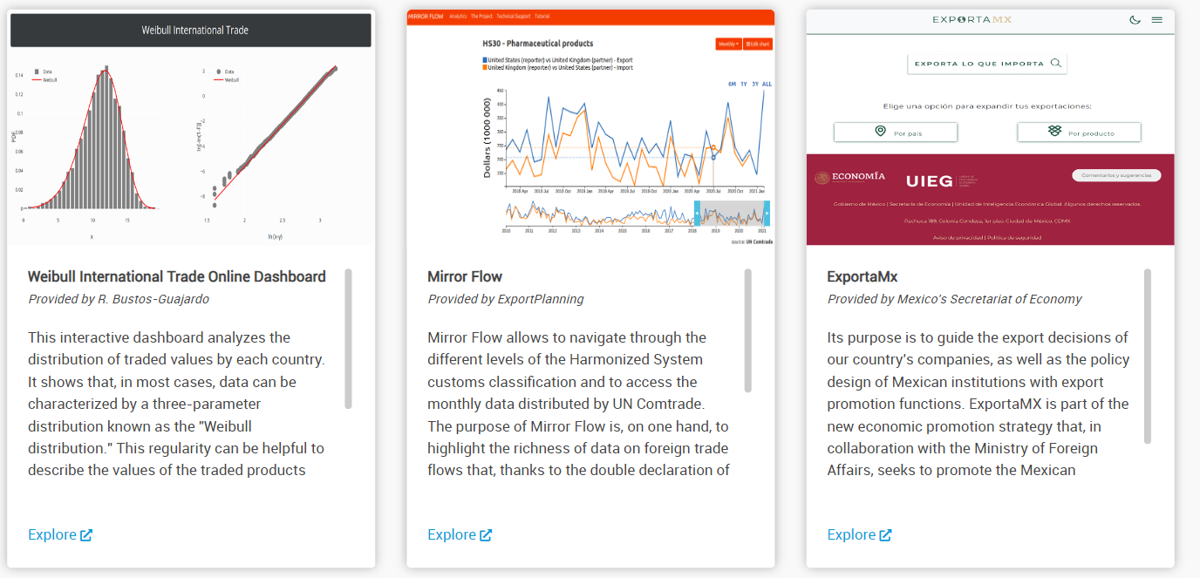
Innovative and experimental uses of UN Comtrade data​
Notes:
Universities or some countries' NSOs.
If you are interested in this, please go to our website to see more use cases.

Slide 31



THANK YOU!
Jiayue Zeng
jiayue.zeng@un.org
https://comtradeplus.un.org/

